Slide 1
CLOUD SECURITY
An Introduction

Slide 2
Introduction.
Cloud computing security or, more simply, cloud security is an evolving sub-domain of computer security, network security, and, more broadly, information security. It refers to a broad set of policies, technologies, and controls deployed to protect data, applications, and the associated infrastructure of cloud computing.

Slide 3
Data Security
Data Confidentiality
Data confidentiality is the property that data contents are not made available or disclosed to illegal users. Outsourced data is stored in a cloud and out of the owners' direct control. Only authorized users can access the sensitive data while others should not gain any information of the data.
Meanwhile, data owners expect to fully utilize cloud data services, e.g., data search, data computation, and data sharing, without the leakage of the data contents to client and other adversaries.

Slide 4
Data Integrity
Data integrity demands maintaining and assuring the accuracy and completeness of data. A data owner always expects that his data in a cloud can be stored correctly and trustworthily. It means that the data should not be illegally tampered, improperly modified, deliberately deleted, or maliciously fabricated.
If any undesirable operations corrupt or delete the data, the owner should be able to detect the corruption or loss

Slide 5
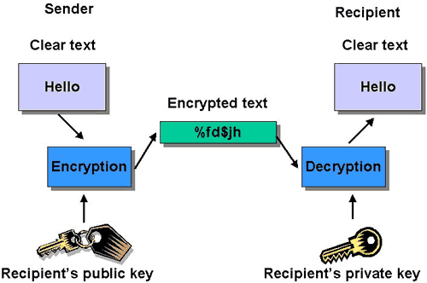
Encryption and Decryption

Slide 6
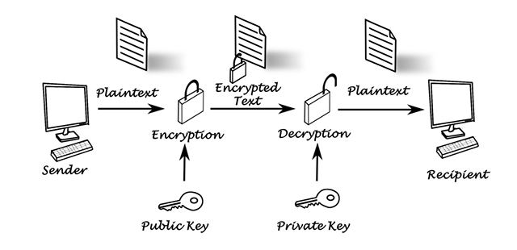
public key encryption
In a public-key encryption system, any person can encrypt a message using the public key of the receiver, but such a message can be decrypted only with the receiver's private key. For this to work it must be computationally easy for a user to generate a public and private key-pair to be used for encryption and decryption

Slide 7
Cloud Security Guidance
1. Audit operational and business processes
2. Manage people, roles and identities
3. Ensure proper protection of data and information
4. Enforce privacy policies

Slide 8
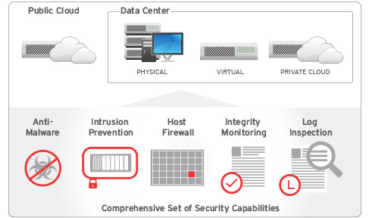

Slide 9
Cloud Security

Slide 10
What is Security?
In Information Technology, security is the protection of information assets through the use of technology, processes, and training.

Slide 11
Security
Security is a principal concern when entrusting an organization’s critical information to geographically dispersed cloud platforms not under the direct control of that organization.

Slide 12
Principles of Information Assurance
Conﬁdentiality
Integrity
Availability
Authentication
Authorization
Auditing

Slide 13
Conﬁdentiality
Confidentiality refers to the prevention of intentional or unintentional unauthorized disclosure of information.

Slide 14
Integrity
Modiﬁcations are not made to data by unauthorized person or processes.
Unauthorized modiﬁcations are not made to data by authorized person or processes.
The data is internally and externally consistent.

Slide 15
Availability
Availability ensures the reliable and timely access to cloud data or cloud computing resources by the appropriate person.
Availability guarantees that the systems are functioning properly when needed

Slide 16
Authentication
Authentication is the testing or reconciliation of evidence of a user’s identity.
It establishes the user’s identity and ensures that users are who they claim to be.
Password-Based Authentication. Almost all server software permits client authentication by means of a name and password. For example, a server might require a user to type a name and password before granting access to the server. The server maintains a list of names and passwords; if a particular name is on the list, and if the user types the correct password, the server grants access.

Slide 17
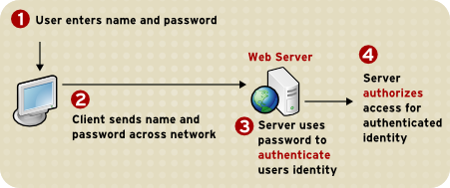

Slide 18
Authorization
Authorization refers to rights and privileges granted to an individual or process that enable access to computer resources and information assets.

Slide 19
Auditing
To maintain operational assurance, organizations use two basic methods:
A system audit is a one-time or periodic event to evaluate security.
Monitoring refers to an ongoing activity that examines either the system or the users, such as intrusion detection.

Slide 20
Cloud Security Design Principles
Least privilege
Defense in depth
Fail safe
Economy of mechanism
Complete mediation
Open design
Least common mechanism
Weakest link
Leveraging existing components

Slide 21
Secure Cloud Software Requirements
It must be dependable under anticipated operating conditions, and remain dependable under hostile operating conditions.
It must be trustworthy in its own behavior, and in its inability to be compromised by an attacker through exploitation of vulnerabilities or insertion of malicious code.
It must be resilient enough to recover quickly to full operational capability with a minimum of damage to itself, the resources and data it handles, and the external components with which it interacts.

Slide 22
Secure Development Practices
Handling data — Some data is more sensitive and requires special handling.
Code practices — Care must be taken not to expose too much information to a would be attacker.
Language options — Consider the strengths and weakness of the language used.
Input validation and content injection — Data (content) entered by a user should never have direct access to a command or a query.
Physical security of the system — Physical access to the cloud servers should be restricted.

Slide 23
Handling Data
Passwords should never be transmitted in the clear. They should always be encrypted.
Passwords should never be viewable on the user’s screen as they are entered into the computer.
Users cannot be provided their Passwords when they forget them. In such cases, the system administrator must enter a new password for the user, which the user can change upon re-entering the application.

Slide 24
Handling Data
Credit card and other ﬁnancial information should never be sent in the clear.
Cloud servers should minimize the transmissions and printing of credit card information. This includes all reports that may be used for internal use, such as troubleshooting, status, and progress reports.
Sensitive data should not be passed to the cloud server as part of the query string, as the query string may be recorded in logs and accessed by persons not authorized to see the credit card information.

Slide 25
Code Practices
The minimum necessary information should be included in cloud server code.
Comments should be stripped from operational code
Names and other personal information should be avoided.
HTML comment ﬁelds should not reveal exploitable information about the developers or the organization.

Slide 26
Physical Security of the System
Provide an uninterruptible power supply (UPS) unit with surge protection.
Provide ﬁre protection to minimize the loss of personnel and equipment.
Provide adequate cooling and ventilation.
Provide adequate lighting and workspace for maintaining and upgrading the system.
Restrict physical access to the server.
Unauthorized persons should not get near the server.

Slide 27
Cloud Software Requirements Engineering
Speciﬁc — The requirement should be unambiguous and direct.
Measurable — The requirement should be measurable to ensure that it has been met.
Attainable — The system must be able to exhibit the requirement under the speciﬁed conditions.
Realizable — The requirement must be achievable under the system and project development constraints.
Traceable — The requirement should be traceable both forward and backward Throughout the development life cycle from conception through design implementation and test.

Slide 28
Cloud Security Policy Implementation and Decomposition
Access controls
Data protection
Conﬁdentiality
Integrity
Identiﬁcation and authentication
Communication security
Accountability

Slide 29
Testing for Security Quality Assurance
Functionality
Reliability
Usability
Efficiency
Maintainability
Portability

Slide 30
Cloud Computing Risk Issues
The CIA Triad
Privacy and Compliance Risks
Threats to Infrastructure, Data, and Access Control

Slide 31
Conﬁdentiality
Network security protocols
Network authentication services
Data encryption services

Slide 32
Integrity
Firewall services
Communications security management
Intrusion detection services

Slide 33
Availability
Fault tolerance for data availability, such as backups and redundant disk systems
Acceptable logins and operating process performance
Reliable and interoperable security processes and network security mechanisms

Slide 34
Other Important Concepts
Identiﬁcation — The means by which users claim their identities to a system.
Authentication — The testing or reconciliation of evidence of a user’s identity.
Accountability — A system’s capability to determine the actions and behaviors of a single individual within a system and to identify that particular individual.
Authorization — The rights and permissions granted to an individual or process that enable access to a computer resource.
Privacy — The level of Conﬁdentiality and privacy protection given to a user in a system.

Slide 35
Privacy and Compliance Risks
Notice — Regarding the collection, use, and disclosure of personally identiﬁable information (PII)
Choice — To opt out or opt in regarding disclosure of PII to third parties
Access — By consumers to their PII to permit review and correction of information
Security — To protect PII from unauthorized disclosure
Enforcement — Of applicable privacy policies and obligations

Slide 36
The Payment Card Industry Data Security Standard (PCI DSS)
Install and maintain a ﬁrewall conﬁguration to protect cardholder data.
Do not use vendor-supplied defaults for system passwords and other security parameters.
Protect stored cardholder data.
Encrypt transmission of cardholder data across open, public networks.
Use and regularly update antivirus software.
Develop and maintain secure systems and applications.

Slide 37
The Payment Card Industry Data Security Standard (PCI DSS)
Restrict access to cardholder data based on the business’s need to know.
Assign a unique ID to each person with computer access.
Restrict physical access to cardholder data.
Track and monitor all access to network resources and cardholder data.
Regularly test security systems and processes.
Maintain a policy that addresses information security.

Slide 38
Information Privacy and Privacy Laws
Statement of the organization’s commitment to privacy
The type of information collected, such as names, addresses, credit card numbers, phone numbers, and so on
Retaining and using e-mail correspondence
Information gathered through cookies and Web server logs and how that information is used
How information is shared with affiliates and strategic partners
Mechanisms to secure information transmissions, such as encryption and digital signatures

Slide 39
Information Privacy and Privacy Laws
Mechanisms to protect PII stored by the organization
Procedures for review of the organization’s compliance with the privacy policy
Evaluation of information protection practices
Means for the user to access and correct PII held by the organization
Rules for disclosing PII to outside parties
Providing PII that is legally required

Slide 40
Threats to Infrastructure, Data, and Access Control
Communications and network security as it relates to voice, data, multimedia, and facsimile transmissions in terms of local area, wide area, and remote access networks
Internet/intranet/extranet in terms of firewalls, routers, gateways, and various protocols

Slide 41
Common Threats and Vulnerabilities
Eavesdropping
Fraud
Theft
Sabotage
External attack

Slide 42
Most common types of attacks
Logon Abuse
Inappropriate System Use
Eavesdropping
Passive eavesdropping
Active eavesdropping
Network Intrusion
Denial-of-Service (DoS) Attacks
Session Hijacking Attacks
Fragmentation Attacks

Slide 43
Cloud Access Control Issues
Backups
RAID (Redundant Array of Independent Disks) technology
Fault tolerance
Business continuity planning
Insurance

Slide 44
Database Integrity Issues
Prevention of the modiﬁcation of information by unauthorized users
Prevention of the unauthorized or unintentional modiﬁcation of information by authorized users
Preservation of both internal and external consistency

Slide 45
Cloud Service Provider Risks
All existing attacks still work.
As a separate system that must be protected, the hypervisor is risk additive.
Aggregating separate systems into VMs increases risk.
An untrusted hypervisor with a trusted VM has a higher risk than a trusted hypervisor with an untrusted VM.

Slide 46
Areas of Risk to Virtualized Systems
Complexity of conﬁguration
Privilege escalation
Inactive virtual machines
Segregation of duties
Poor access controls

Slide 47
Other Types of Attacks
Back-Door
Spooﬁng
Man-in-the-Middle
Replay
TCP Hijacking
Social Engineering
Dumpster Diving
Password Guessing
Trojan Horses and Malware

Slide 48
Social Engineering
E-mails to employees from a cracker requesting their passwords to validate the organizational database after a network intrusion has occurred
E-mails to employees from a cracker requesting their passwords because work has to be done over the weekend on the system
E-mails or phone calls from a cracker impersonating an official who is conducting an investigation for the organization and requires passwords for the investigation
Improper release of medical information to individuals posing as doctors and requesting data from patients’ records
A computer repair technician convinces a user that the hard disk on his or her PC is damaged and irreparable and installs a new hard disk. The technician then takes the hard disk, extracts the information, and sells the information to a competitor or foreign government.

Slide 49
Security Policy Implementation
Security policies are the foundation of a sound security implementation. Often organizations will implement technical security solutions without ﬁrst creating this foundation of policies, standards, guidelines, and procedures, unintentionally creating unfocused and ineffective security controls.

Slide 50
Policy Types
Senior Management Statement Policy - This is a general, high-level policy that acknowledges the importance of the computing resources to the business model; states support for information security throughout the enterprise; and commits to authorizing and managing the definition of the lower-level standards, procedures, and guidelines.
Regulatory Policies - Regulatory policies are security policies that an organization must implement due to compliance, regulation, or other legal requirements. These companies might be ﬁnancial institutions, public utilities, or some other type of organization that operates in the public interest.

Slide 51
Policy Types
Advisory Policies - Advisory policies are security policies that are not mandated but strongly suggested, perhaps with serious consequences defined for failure to follow them(such as termination, a job action warning, and so forth). A company with such policies wants most employees to consider these policies mandatory.
Informative Policies - Informative policies are policies that exist simply to inform the reader. There are not implied or specified requirements, and the audience for this information could be certain internal (within the organization) or external parties.

Slide 52
Virtual Threats
Shared clipboard
Keystroke logging
VM monitoring from the host
Virtual machine monitoring from another VM
Virtual machine backdoors

Slide 53
Virtual Threats
Shared clipboard — Shared clipboard technology allows data to be transferred between VMs and the host, providing a means of moving data between malicious programs in VMs of different security realms.
Keystroke logging — Some VM technologies enable the logging of keystrokes and screen updates to be passed across virtual terminals in the virtual machine, writing to host files and permitting the monitoring of encrypted terminal connections inside the VM.

Slide 54
Virtual Threats
VM monitoring from the host — Because all network packets coming from or going to a VM pass through the host, the host may be able to affect the VM by the following:
Starting, stopping, pausing, and restart VMs
Monitoring and configuring resources available to the VMs,
including CPU, memory, disk, and network usage of VMs
Adjusting the number of CPUs, amount of memory, amount
and number of virtual disks, and number of virtual network
interfaces available to a VM
Monitoring the applications running inside the VM
Viewing, copying, and modifying data stored on the VM’s
virtual disks

Slide 55
Virtual Threats
Virtual machine monitoring from another VM — Usually, VMs should not be able to directly access one another’s virtual disks on the host. However, if the VM platform uses a virtual hub or switch to connect the VMs to the host, then intruders may be able to use a hacker technique known as “ARP poisoning” to redirect packets going to or from the other VM for sniffing.
Virtual machine backdoors — A backdoor, covert communications channel between the guest and host could allow intruders to perform potentially dangerous operations.

Slide 56
VM Security Recommendations
Hardening the Host Operating System
Limiting Physical Access to the Host
Using Encrypted Communications
Disabling Background Tasks
Updating and Patching
Enabling Perimeter Defense on the VM
Implementing File Integrity Checks
Maintaining Backups

Slide 57
Hardening the Host Operating System
Use strong passwords, such as lengthy, hard to guess passwords with letters, numbers, and symbol combinations, and change them often.
Disable unneeded services or programs, especially networked services.
Require full authentication for access control.
The host should be individually firewalled.
Patch and update the host regularly, after testing on a non-production unit.

Slide 58
Limiting Physical Access to the Host
Require card or guard access to the room with the machines.
Use locks to anchor the machines to the building, and/or lock the cases to prevent removal of the hard drives.
Remove floppy and CD drives after initial setup.
In the BIOS, disable booting from any device except the primary hard drive. Also, password protect the BIOS so the boot choice cannot be changed.
Control all external ports through host and guest system configuration or third-party applications

Slide 59
Using Encrypted Communications
Encryption technologies, such as Secure HTTP (HTTPS), encrypted Virtual Private Networks (VPNs), Transport Layer Security (TLS), Secure Shell (SSH), and so on should be used to provide secure communications links between the host domain and the guest domain, or from hosts to management systems. Encryption will help prevent such exploits as man-in-the-middle (MITM), spoofed attacks, and session hijacking.

Slide 60
Thank You

